Slide 1
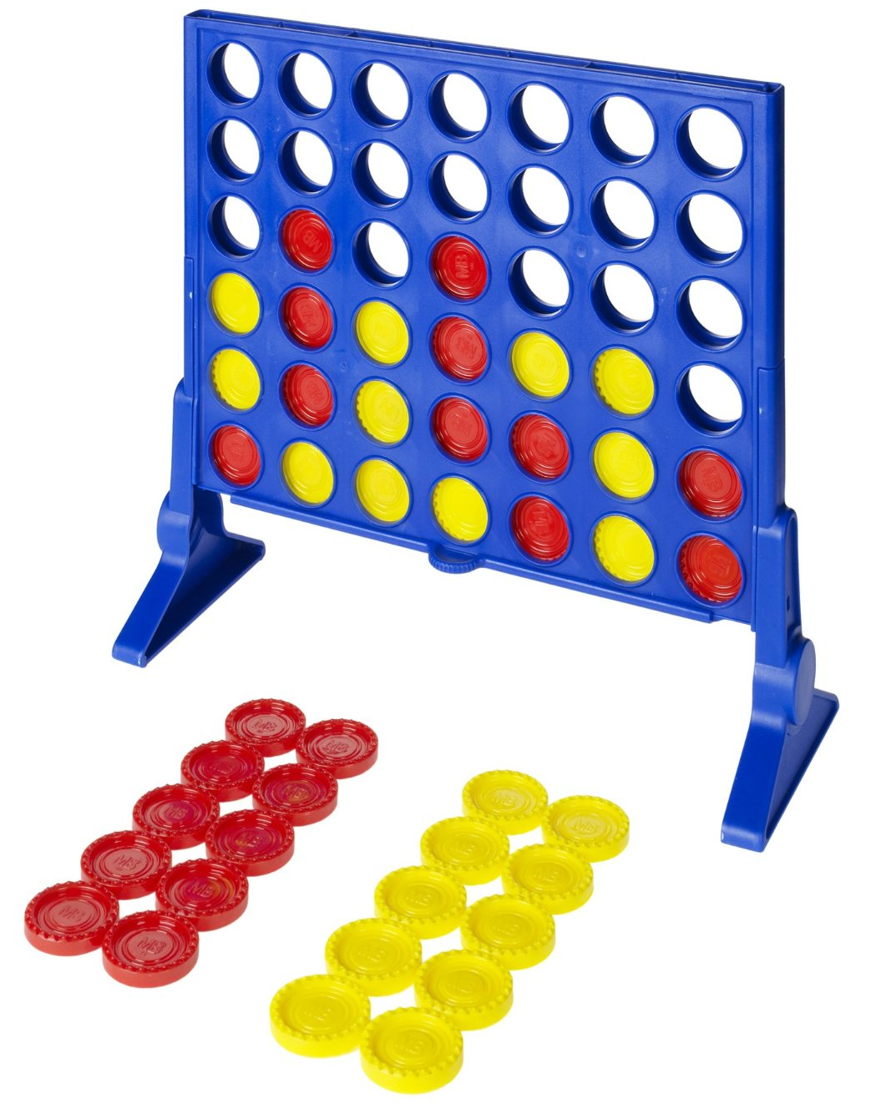
ARTIFICIAL INTELLIGENCE PROJECT
CONNECT FOUR
Kamal Atluri
Yasasvi Yeleswarapu
Leeladhar Reddy Munnangi

Slide 2
Game Rules
Consists of Eight-column, Six-row vertically suspended grid.
Players starts the game by dropping colored discs from the top.
The pieces fall straight down, occupying the next available space within the column.
Objective
Connect four of one's own discs of the same
color next to each other
Vertically
Horizontally
Diagonally

Slide 3
Four Different Heuristics
Number of winning lines
How many pieces in a row will i get if I move here
Do I block a good path for the enemy if I move here ?
Does the space above give the opponent an advantage ?

Slide 4
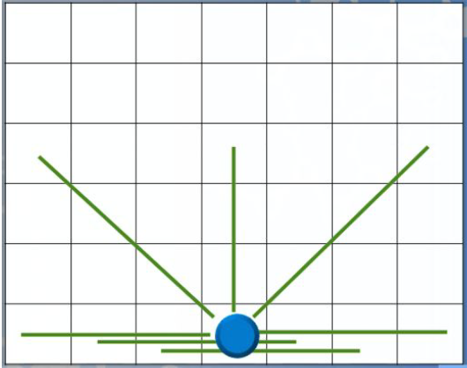
Position for max possibilities

Slide 5
Implementation
Game board with size 8x6 which gives 48 slots for the players.
Implementing in Java.
Algorithms : Min-Max , Alpha-Beta Pruning.
Mode : Human VS computer.
Number of moves.
Time taken by computer to make a move(in Milliseconds).

Slide 6
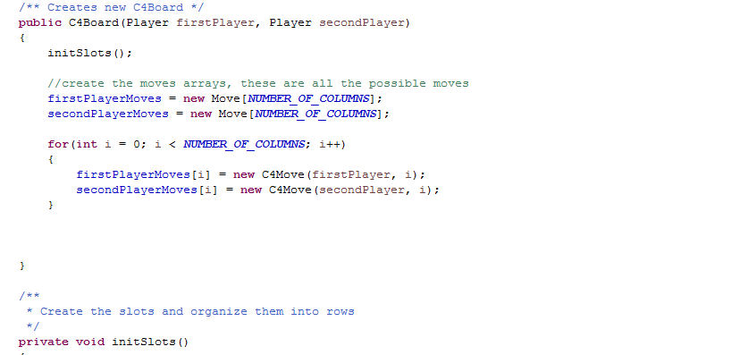
Game Board

Slide 7
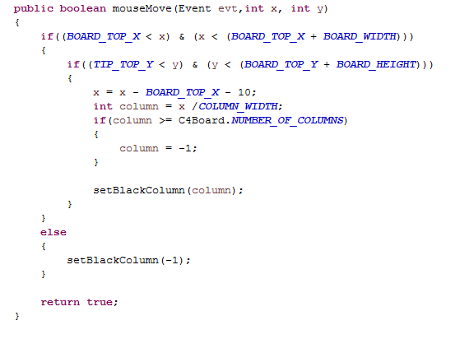
Tracking the mouse

Slide 8
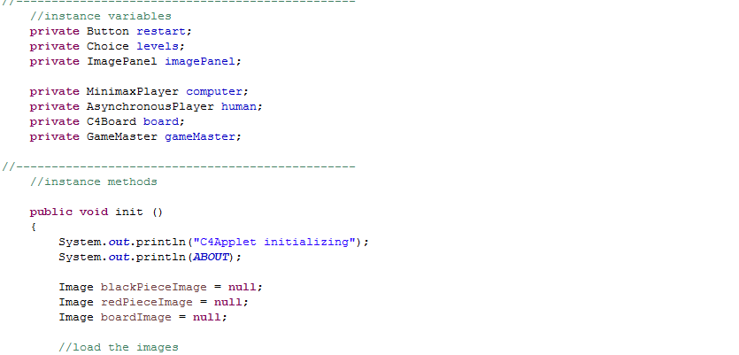
Applet Code

Slide 9
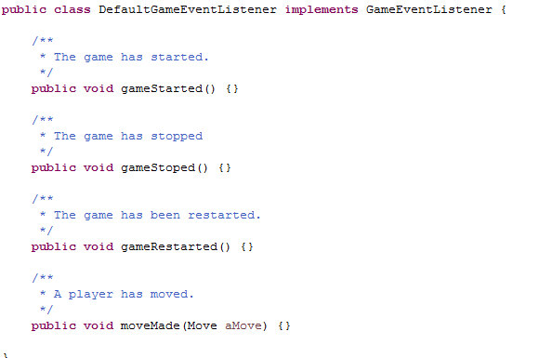
Game Event Listener

Slide 10
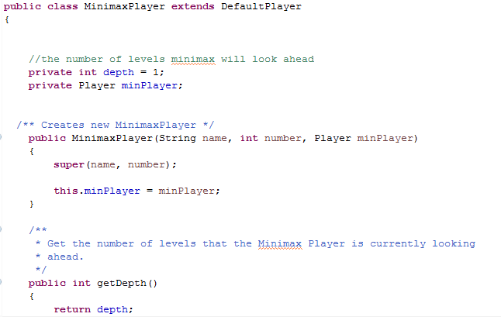
MiniMax Code

Slide 11
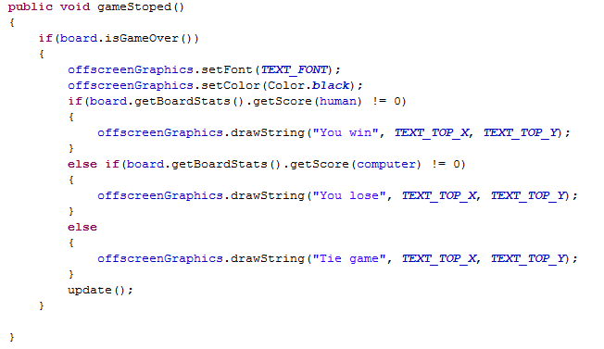
Game over

Slide 12


